Slide 1


HITORNOT

Slide 2


DATA
Kaggle's Spotify top chart songs 2022
646 rows and 17 columns
weeks on charts
WHAT YOU NEED TO KNOW
APPROACH
Linear Regression, Random Forest and KNN

Slide 3
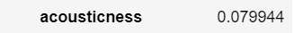
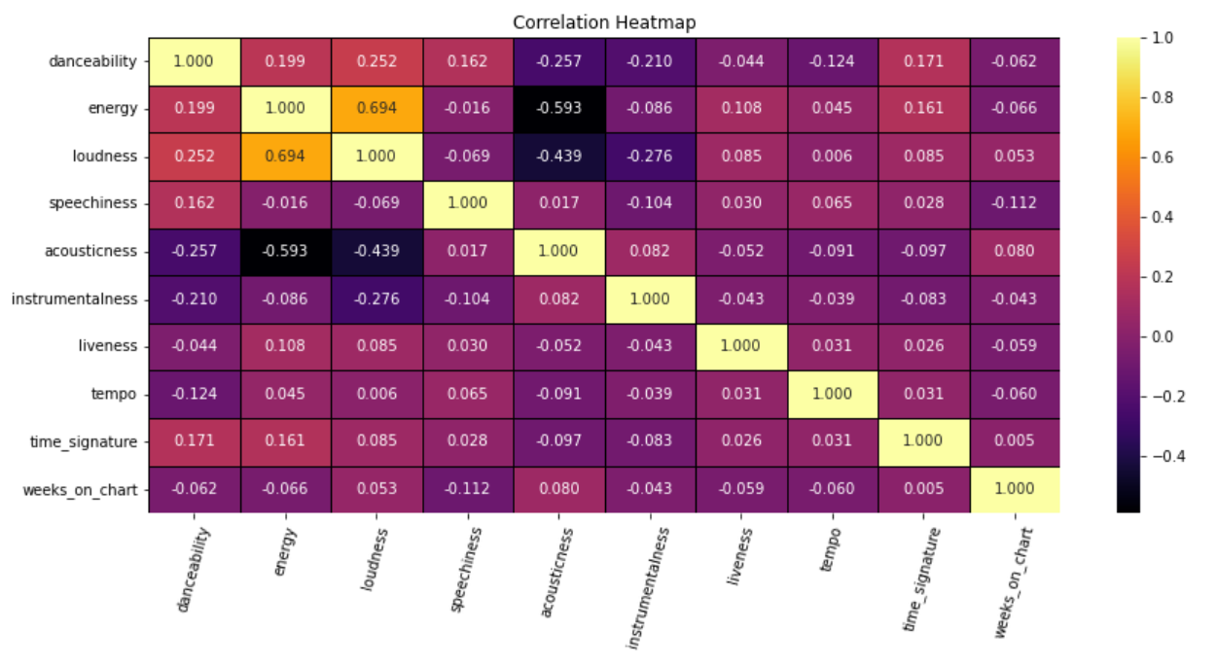



Slide 4
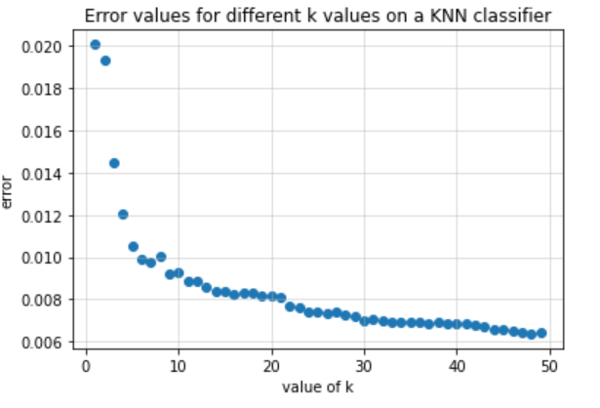
Linear Regression
K-Nearest Neighbors
MODELING
KNN
Linear Regression
'RMSE': 35.98, 'RSquared ': 0.11
Testing error is 0.009559899651344114

Slide 5
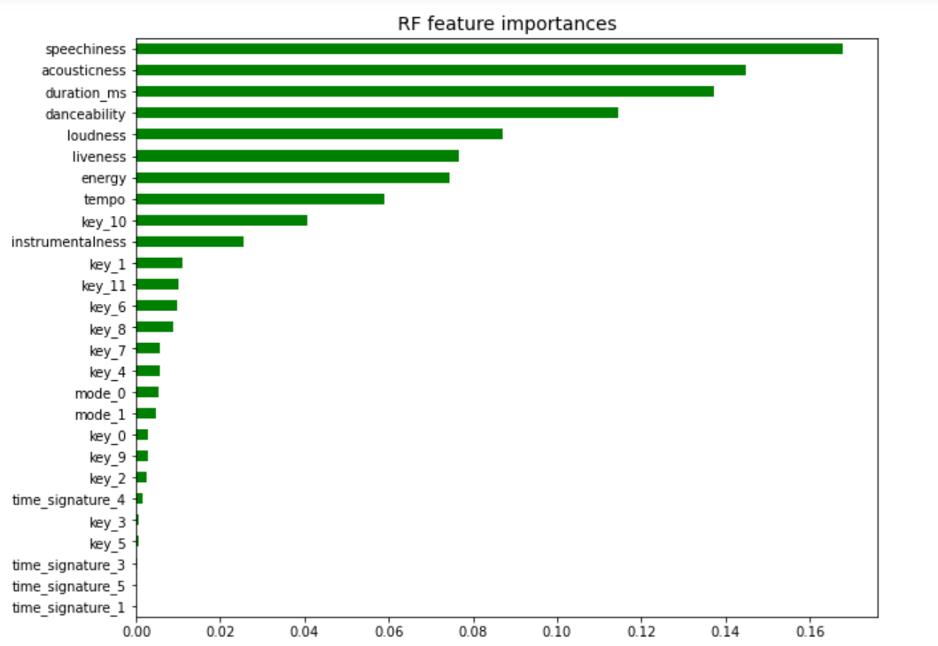
Random Forest
MODELING
Random Forest
'RMSE': 14.51, 'RSquared ': 0.85
speechiness is most important feature
No feature dominated the rest

Slide 6



STUDIO SHODWE
Thank You

